Slide 1
FAS 424
Animal Models in Biomed. Res.
Types of Animal Models Used in Biomedical Research

Slide 2
Types of Animal Models
Spontaneous or Natural Models - These include diseases or conditions that occur naturally in animals as in humans.
  For example, features of type I diabetes in the non-obese diabetic (NOD) mouse and biobreeding (BB) rat closely resemble the same condition in humans.

Slide 3
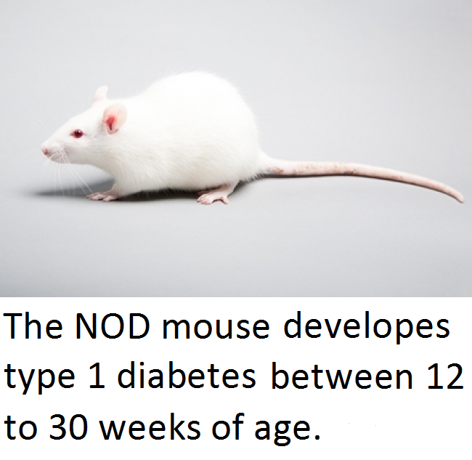
Types of Animal Models

Slide 4
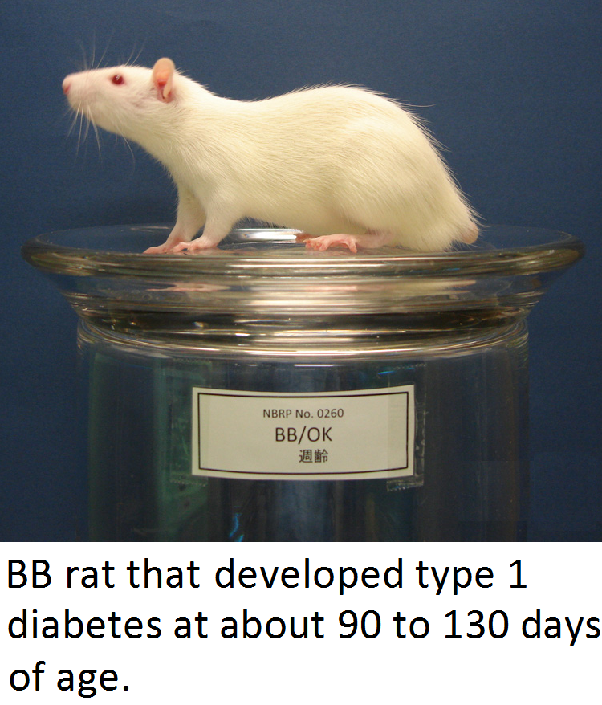
Types of Animal Models

Slide 5
Types of Animal Models
    Type I diabetes develops when T cells, white blood cells that play a central role in the immune response, get a signal to destroy insulin-producing β cells of the pancreas.
      Insulin, a hormone, is needed to allow sugar (glucose) to enter cells to yield energy.

Slide 6
Types of Animal Models
  Other examples include hypertension, arthritis, and cancer.

Slide 7
Types of Animal Models
Experimental Models - These are models in which a disease or condition is experimentally reproduced by the scientist.
  Diabetes in rodents has been induced experimentally by using the chemicals streptozotocin and alloxan to damage the insulin-producing β cells of the pancreas.

Slide 8
Types of Animal Models
  Colorectal cancer in rodents has been induced experimentally by using the chemicals dimethylhydrazine and azoxymethane to produce tumors.
  Orthotopic implantation of tumor cells or tumor tissue has also been used to produce a rodent model that is useful for testing new therapeutic agents against colorectal cancer.

Slide 9
Types of Animal Models
Genetically-Engineered Models - These are a particular group of induced animal models, involving manipulation of the animal’s genetic code to create the condition that the scientist wants to study.

Slide 10
Types of Animal Models
  A genetically modified mouse may carry inserted foreign DNA in their genome. This involves injecting genetic material (typically linear DNA) into the nucleus of a fertilized immature ovum, where it will randomly integrate into the mouse’s genome.

Slide 11
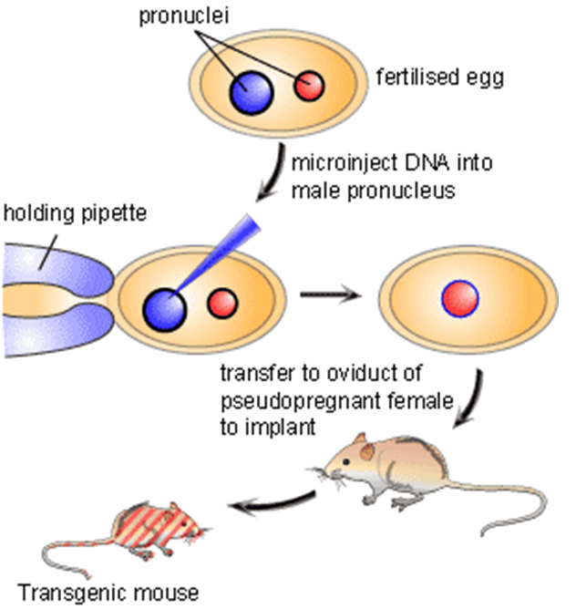
Types of Animal Models

Slide 12
Types of Animal Models
  A genetically modified mouse may have genes replaced or removed (“knock-out” models). This involves modifying embryonic stem cells (undifferentiated cells) with a DNA construct containing DNA sequences homologous to the target gene. Embryonic stem cells that recombine with genomic DNA are selected for and they are then injected into the mouse’s blastocyst.

Slide 13
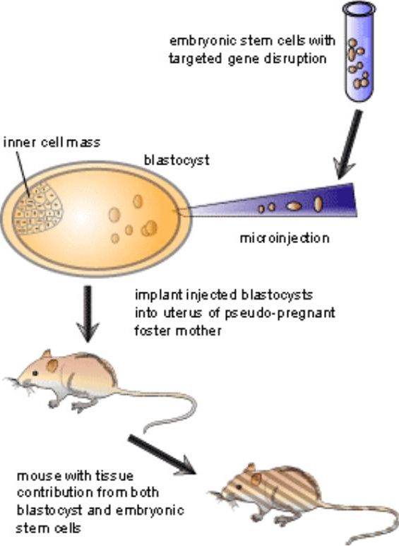
Types of Animal Models

Slide 14
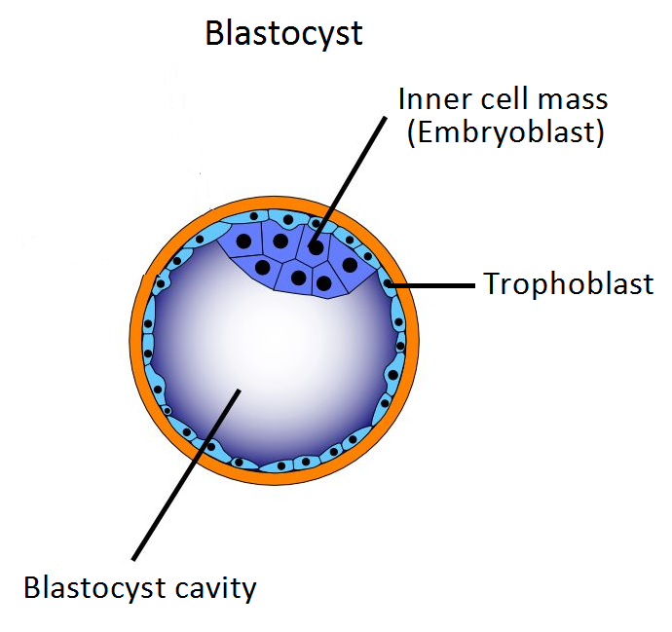
Types of Animal Models

Slide 15
Types of Animal Models
  These models can help scientists study the genetic basis of disease, susceptibility and resistance, etc. Genetically modified mice have been used to study and model obesity, heart disease, diabetes, arthritis, substance abuse, anxiety, aging and Parkinson disease.

Slide 16
Types of Animal Models
Negative Models - These models involve animal species, strains, or breeds that fail to react to a particular disease or chemical stimulus. Examining why this is the case may provide answers to questions about disease resistance and its physiological basis.

Slide 17
Types of Animal Models
  Rabbits fail to develop gonococcal infection subsequent to exposure to an experimental treatment that induces the disease in other animals.

Slide 18
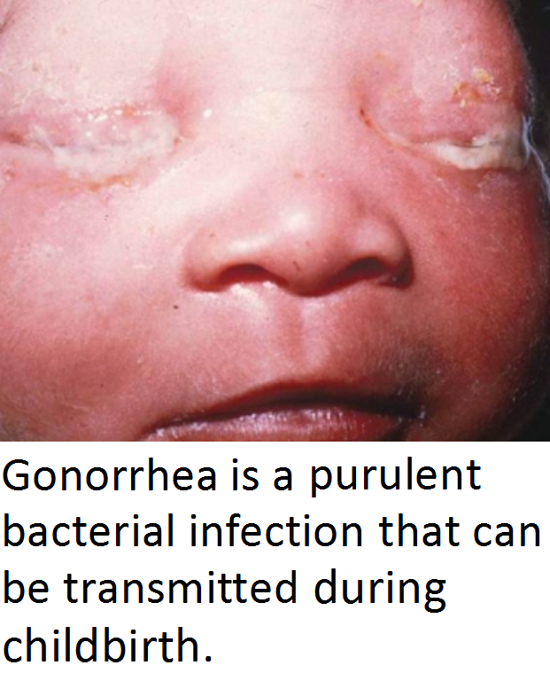
Types of Animal Models

Slide 19
Types of Animal Models
Orphan Models - These models are diseases or conditions that occur naturally in an animal, but there is no known correlation to human disease.
  Scrapie, a neurodegenerative disease caused by a prion, affects sheep and goats, but cannot be transmitted to humans.

Slide 20
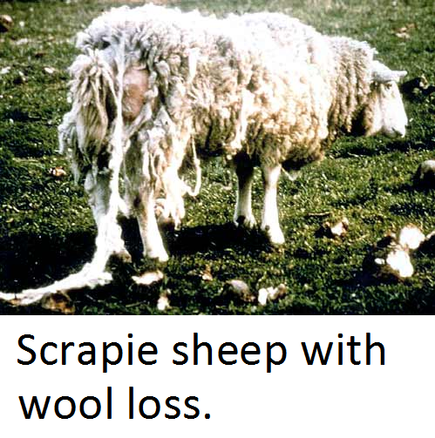
Types of Animal Models

Slide 21
Types of Animal Models
  As with other transmissible spongiform encephalopathies, no effective treatments or vaccines are yet available for scrapie.
    Note: A prion is a misfolded protein molecule which may propagate by transmitting a misfolded protein state.

Slide 22
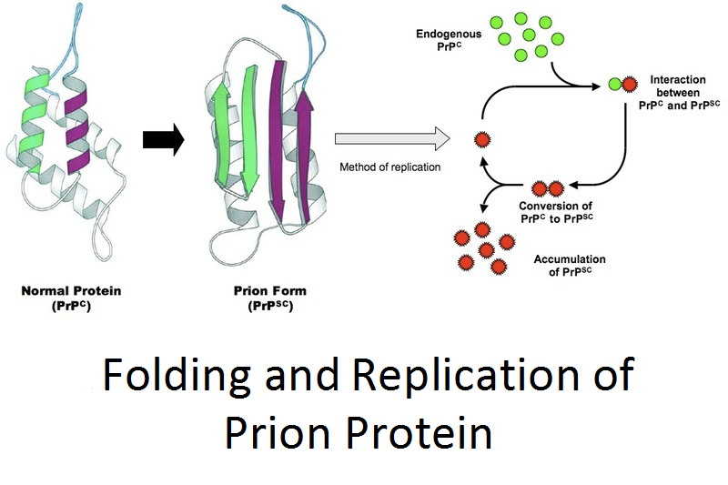
Types of Animal Models

Slide 23
Types of Animal Models
    This infectious protein molecule causes mammalian transmissible spongiform encephalopathies, including bovine spongiform encephalopathy (BSE), also known as “mad cow disease” and scrapie in sheep and goats. Because a prion is not considered a living organism, it is resistant to treatments that ordinarily destroy bacteria, spores, viruses and fungi.

